Slide 1


Loading Page

Slide 2

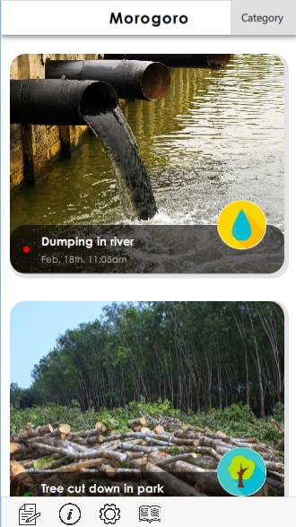
Note:
- The news feed is scrollable
Home Page
Location
Incident Image
Sort the type of pollution
Title of the incident
Incident type
Information on what is this app about
Report indicator
Red dot = in process
Green dot = solved
Date and time
when reported
User setting
Add new report
Information on all types of
environmental misconduct

Slide 3

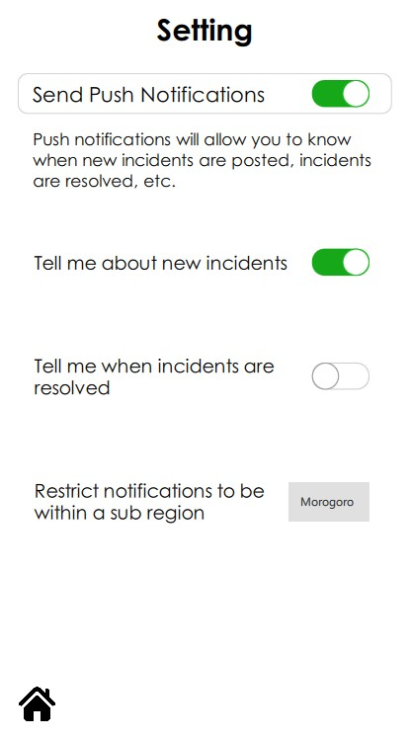
Note:
- Can turn all push notifications on/off, can specify below
Settings Page
Text explaining push notifications
Switch button
Defaults to Morogoro which is the entire region, can choose smaller, sub-regions from drop-down menu
Return to home page

Slide 4

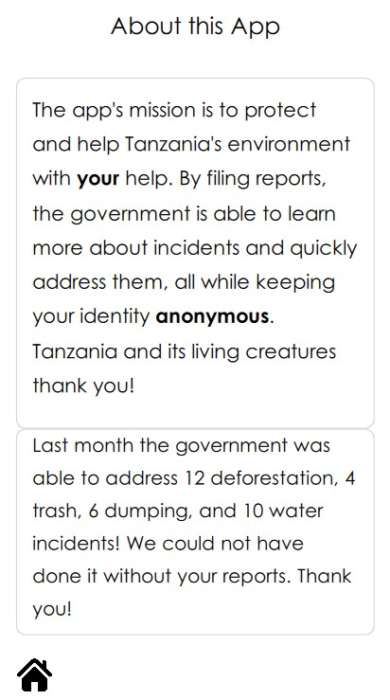
About This App Page
Once the app is in use, we can upload short statistics on this page
Return to home page

Slide 5

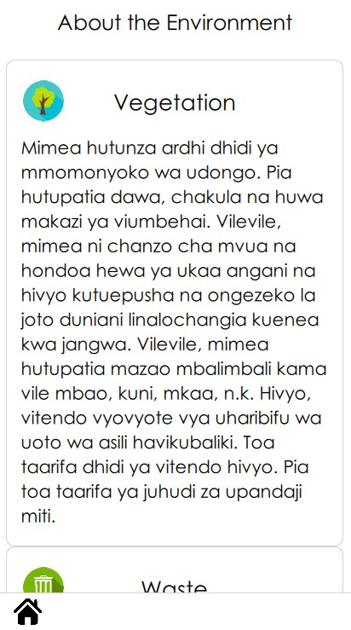
Note:
- There are total of 9 categories
Education Page
Category icon
Category title
Users scroll to read all 9 categories of info
Return to home page

Slide 6
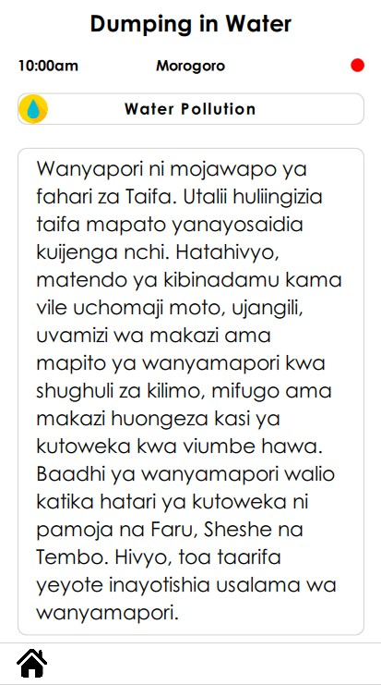
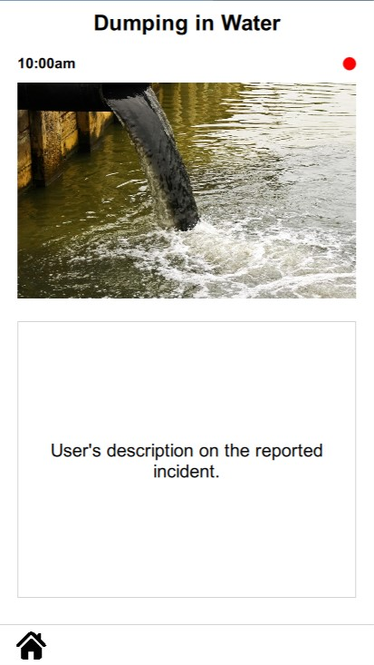
Incident Information Page (news feed)
Title of the report
Dot:
Red = working in progress
Green = solved
Time incident reported
Icon indicates the misconduct type
The photo that user took when submit the report
Scroll down
Facts and effects on the pollution
Description of the report
Home page icon. Click to return to home page

Slide 7

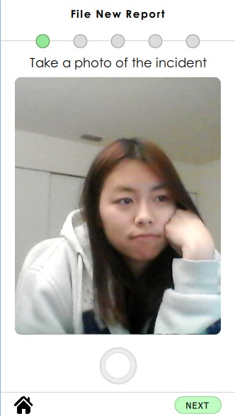
Note:
- 5 steps to complete the report
Report Image Page
The five circles represent the five steps to complete the report.
Green = currently on the page
Gray = not yet complete
Access the front camera of the phone
Press the button to take the picture or hold the button to take the video
Return to home page
Go to next step

Slide 8
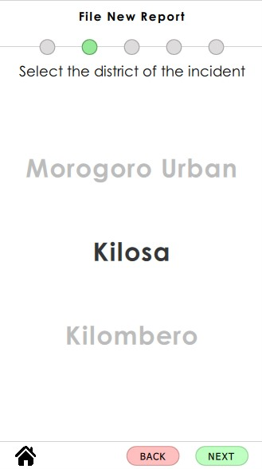
Note:
- Total of 9 locations
Report Location Page
Pick the district of the incident.
Able to scroll to select the district
Return to previous page

Slide 9
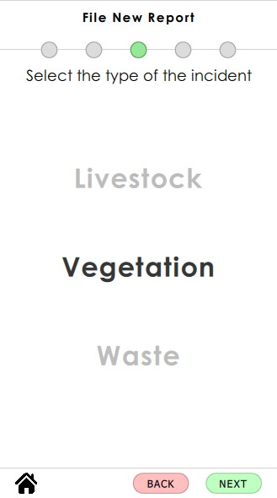
Report Type Page
Pick the type of the incident.
Able to scroll to select the type

Slide 10
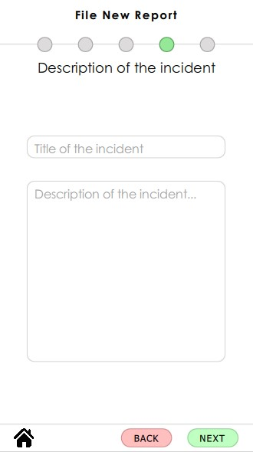
Report Description Page
Enter the title of the incident
Description of the incident

Slide 11
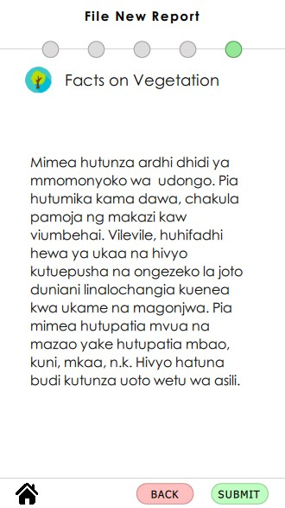
Note:
- This page will show the facts based on the type of the incident that the user picked earlier (Report Type Page)
Report Description Page
Icon for type of the incident
Facts on type of the incident
Ready to submit the report

Slide 12
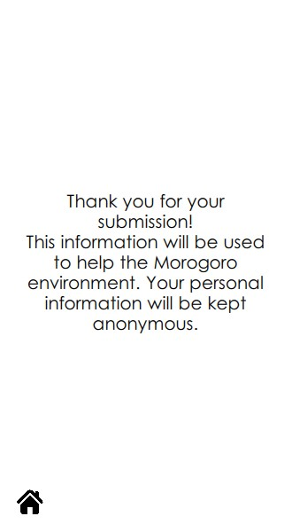
Thank You Page
Thank the user for report the incident
Return to Home page

